Slide 1
Apps on Azure
Boralex Market Use-case

Slide 2
1-Prepare
Containerized App (DockerHub registry)
CI/CD with GitHub Actions
Supervisiontools on GH
Workflow tool (Prefect)

Slide 3
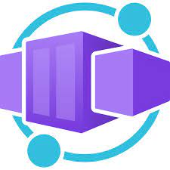

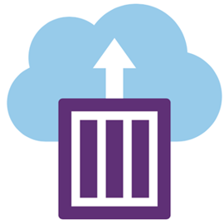


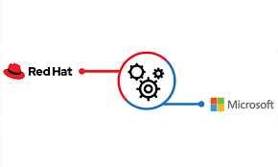

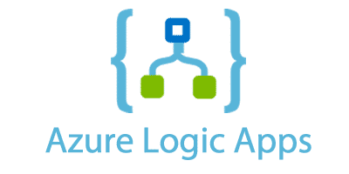
Azure Full-fledged solutions - which one ? (https://learn.microsoft.com/en-us/azure/container-apps/compare-options)
Azure Container App
Azure App Service
ACI (Azure Container Instance)
AKS (Azure Kubernetes Service)
Azure Functions (serverless compute service)
Azure Spring App
Azure Red Hat OpenShift
Azure Logic Apps (workflow integration platform)

Slide 4
Deploy
From GitHub : https://learn.microsoft.com/fr-fr/cli/azure/container/app?view=azure-cli-latest
From Docker CLI : https://docs.docker.com/cloud/aci-integration/

Slide 5

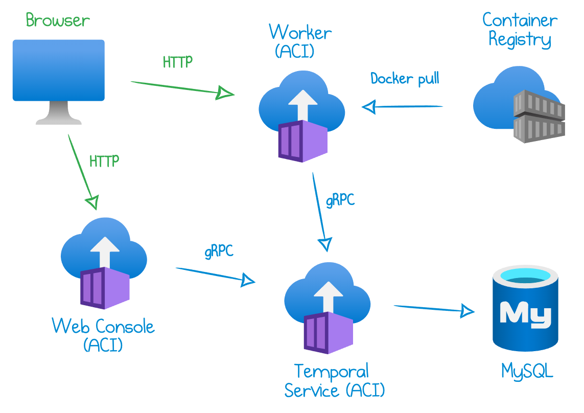
Wokflow App alternative
https://temporal.io/how-temporal-works
Deployed ON ACI : https://mikhail.io/2020/10/how-to-deploy-temporal-to-azure-container-instances/

